Slide 1
Introduction to Scala
Lecturer: Ngo Huy Bien
Software Engineering Department
Faculty of Information Technology
VNUHCM - University of Science
Ho Chi Minh City, Vietnam
nhbien@fit.hcmus.edu.vn

Slide 2

Objectives
To create a program using Scala.

Slide 3

Contents

Slide 4

References
Dean Wampler (2021). Programming Scala. O'Reilly Media.

Slide 5
What is Scala? [1]
Scala is a language that addresses the needs of the modern software developer.
It is a statically typed, object-oriented, and functional mixed-platform language with a succinct, elegant, and flexible syntax, a sophisticated type system, and idioms that promote scalability from small tools to large sophisticated applications.
The name Scala is a contraction of the words scalable language.
Scala was started by Martin Odersky in 2001. The first public release was January 20, 2004.

Slide 6
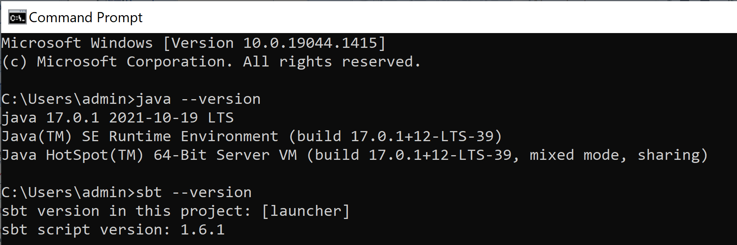
Install Scala
https://docs.scala-lang.org/scala3/getting-started.html
Java JDK: https://www.oracle.com/java/technologies/downloads/
Scala build tool: https://www.scala-sbt.org/download.html
Restart your computer
java --version
sbt --version

Slide 7
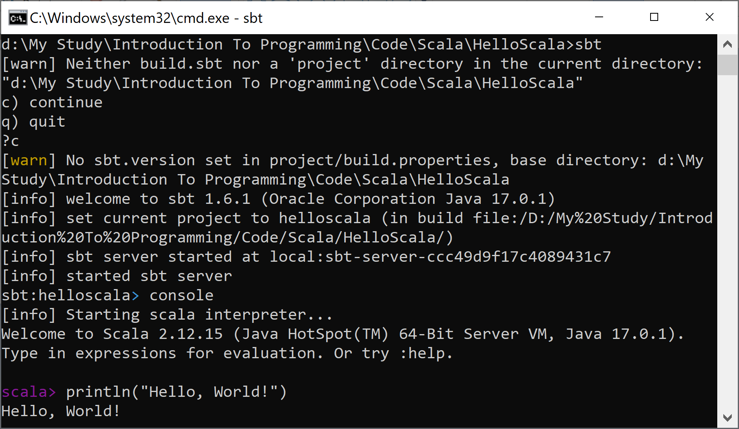
Hello World
sbt
console
println("Hello, World!")

Slide 8

Further Reading

Slide 9

Thank You & See You Again

